Slide 1
Interpretation and Application of the Graphical Forecasts for Aviation (GFA)
Developed
by
Terry Lankford

Slide 2
DEVELOPMENT
The Aviation Weather Center has been developing a graphical replacement for the text FA for over a decade.
In June 2014 the FAA and NWS announced a request for comments to transition to digital and graphical products.
In the spring of 2016 the experimental GFA became available on the AWC's web site.
The GFA became operational in April 2017.
Text FAs were discontinue for the CONUS in October 2017.

Slide 3
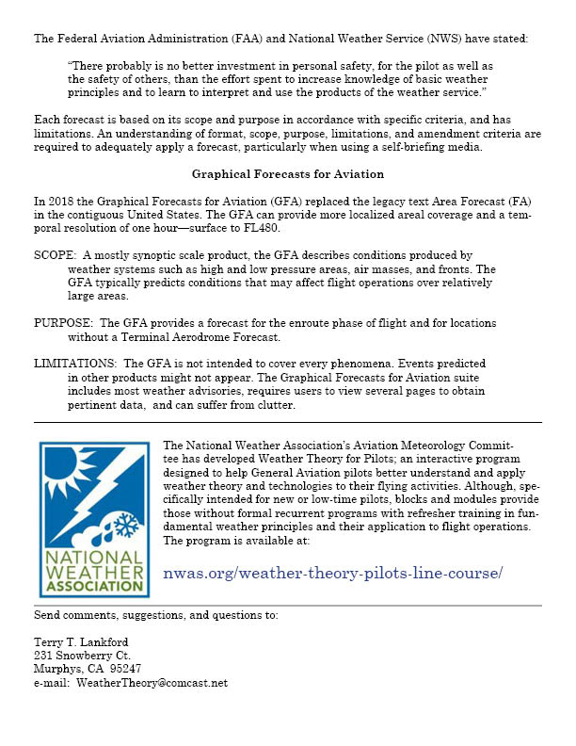

Slide 4
Weather Card URL Sights
NWA Weather Theory for Pilots
Introduction¹ | Application of Weather Theory² | Aviation Weather Forecasts³
Moisture | Low Ceilings and Visibility | Weather Advisories
Vertical Motion | Altimetry | Area Forecasts
Stability | Low-Level Wind Shear | Terminal Aerodrome Forecasts
 |  | Aircraft Performance⁴
¹Published as a pdf.
²Available on request.
³Under revision.
⁴Adobe Flash format.

Slide 5
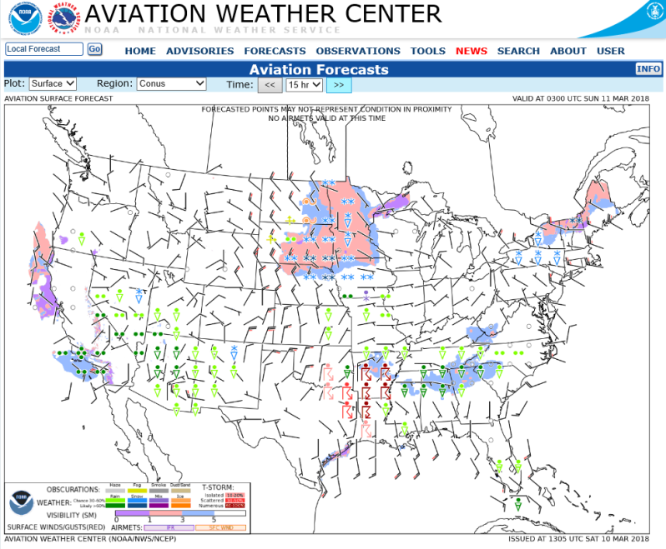
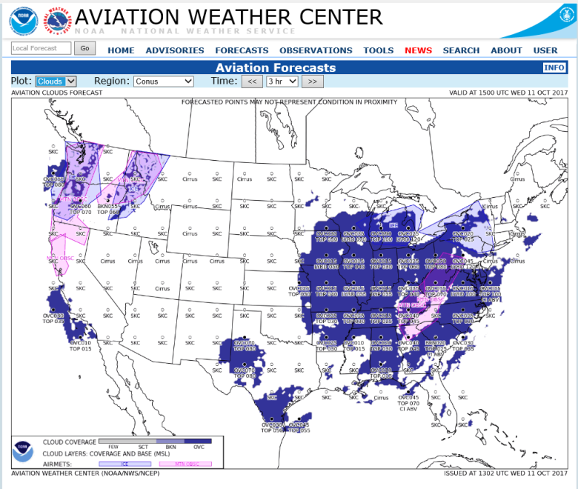
Aviation Surface & Clouds Forecast graphics
The AWC produces Aviation Surface Forecast and Aviation Clouds Forecast graphics as a low-bandwidth alternative to the Graphical Forecasts for Aviation suite. These static images provide graphical forecasts for Flight Service (Flight Service—Leidos—Pilot Web Portal) and other users with limited Internet.

Slide 6
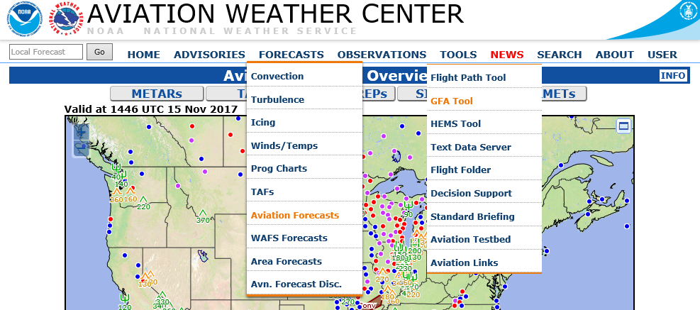
AVAILABILITY
The GFA/Aviation Forecasts are available on the AWC web site at: www.aviationweather.gov.

Slide 7
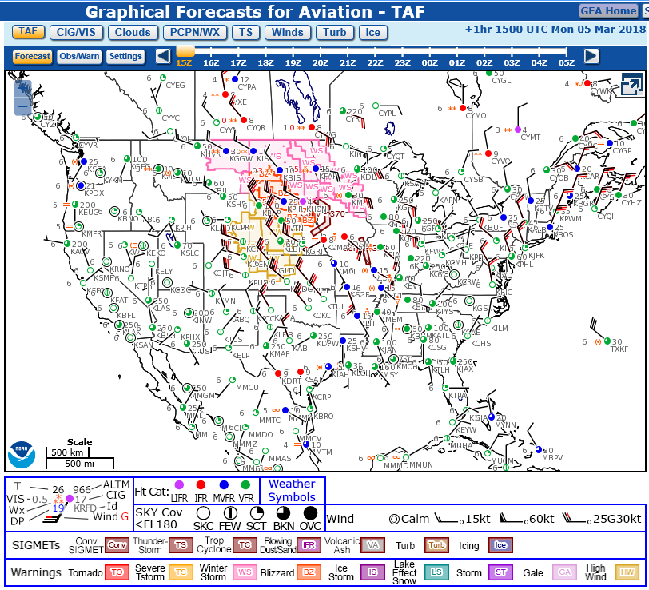
MENU
BAR
PRODUCT VIEW AREA
LEGEND

Slide 8
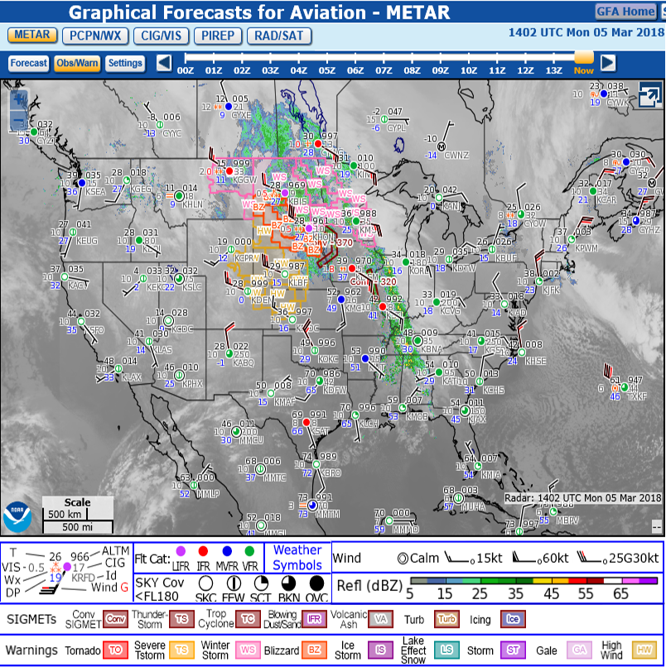

Slide 9
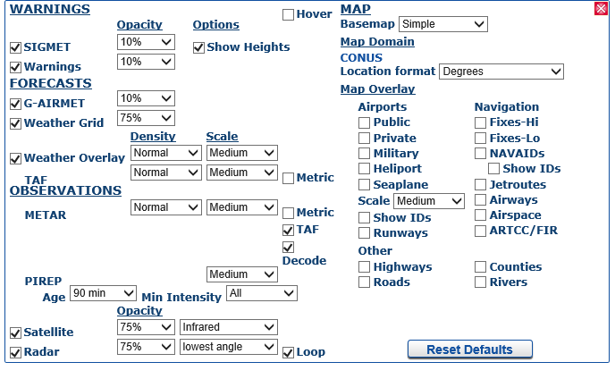
SETTINGS

Slide 10
WARNING
SIGMETs only display during the valid time of the product (usually four hours). When SIGMETs continue beyond (CONTG BYD) their valid time, the SIGMET is NOT displayed.
At present, Center Weather Advisories (CWA) are NOT displayed.

Slide 11
FORECASTS
TAF—Terminal Aerodrome Forecasts
CIG/VIS—Ceilings/Visibilities
Clouds
PCPN/WX—Precipitation/Weather
TS—Thunderstorms
Winds
Turb—Turbulence
Ice

Slide 12
OBS/WARN (OBSERVATIONS and WARNINGS)
METAR
PCPN/WX—Precipitation and Weather
CIG/VIS—Ceilings and Visibilities
PIREP
RAD/SAT—Radar and Satellite

Slide 13
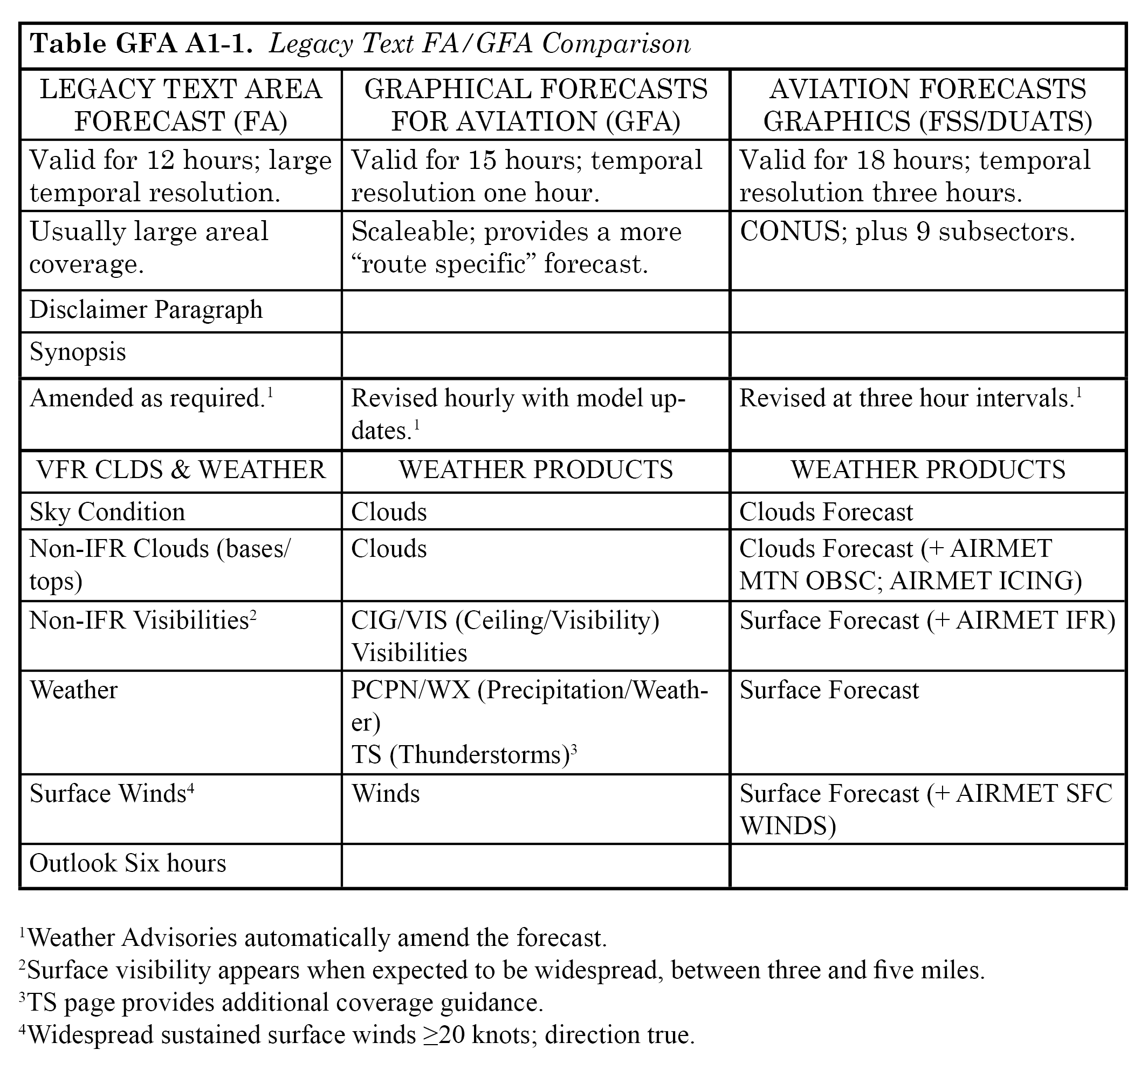

Slide 14
WARNING
Like the legacy text FA, the GFA suite/Aviation Surface and Clouds Forecast Graphics are NOT a substitute for a complete (standard) weather briefing. Weather Advisories must be considered; most—NOT ALL—are available on individual GFA pages.

Slide 15
CAUTION
Although GFA temporal coverage is one hour (Aviation Surface/Clouds Forecasts three hours), pilots should review conditions before and after proposed flight time—to determine trend. When using the GFA suite, the display of too much data on a single page may obscure important information.

Slide 16
OAKLAND, CA – SALT LAKE CITY, UT

Slide 17
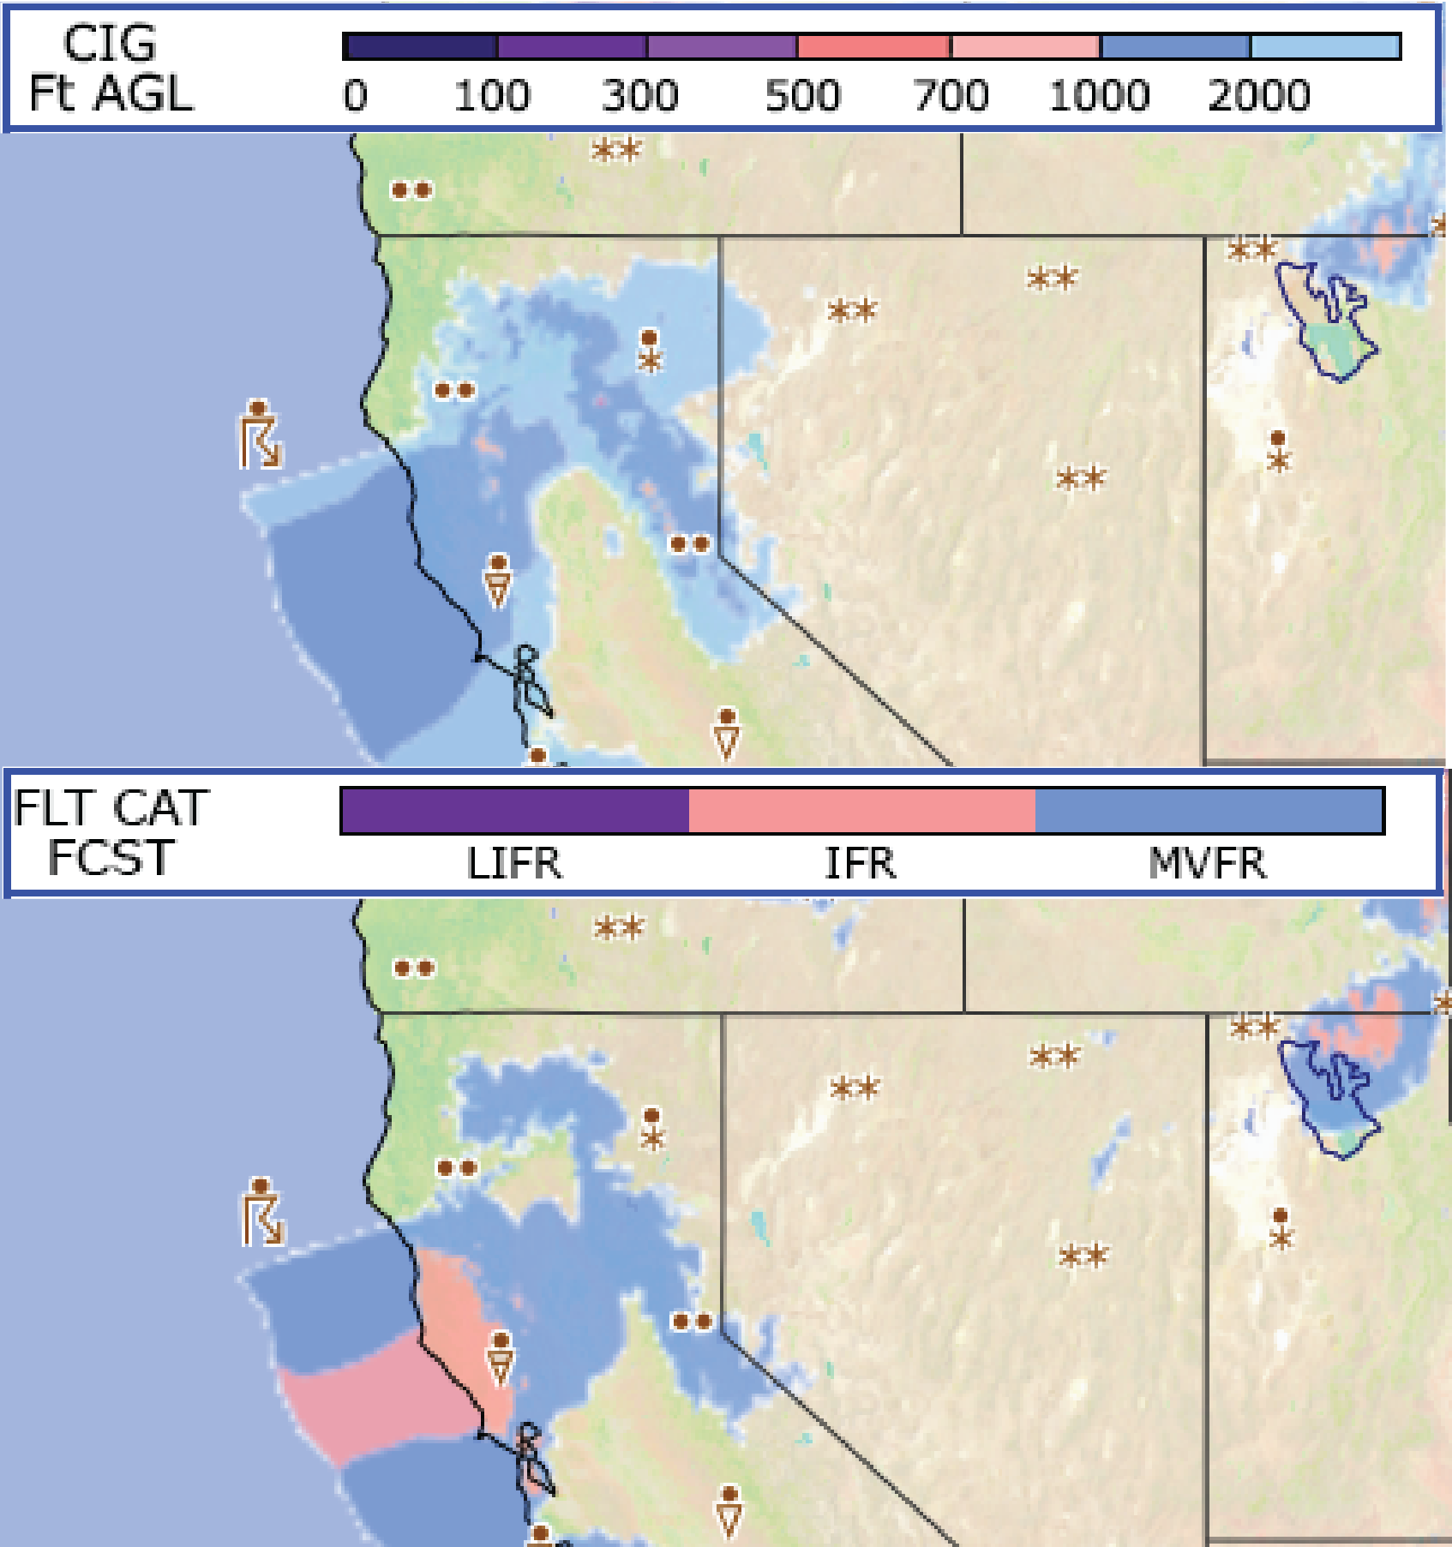
CIG/VIS (Ceilings-Visibility)

Slide 18
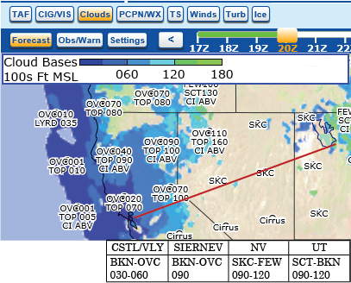
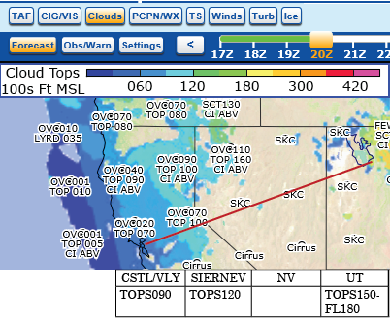
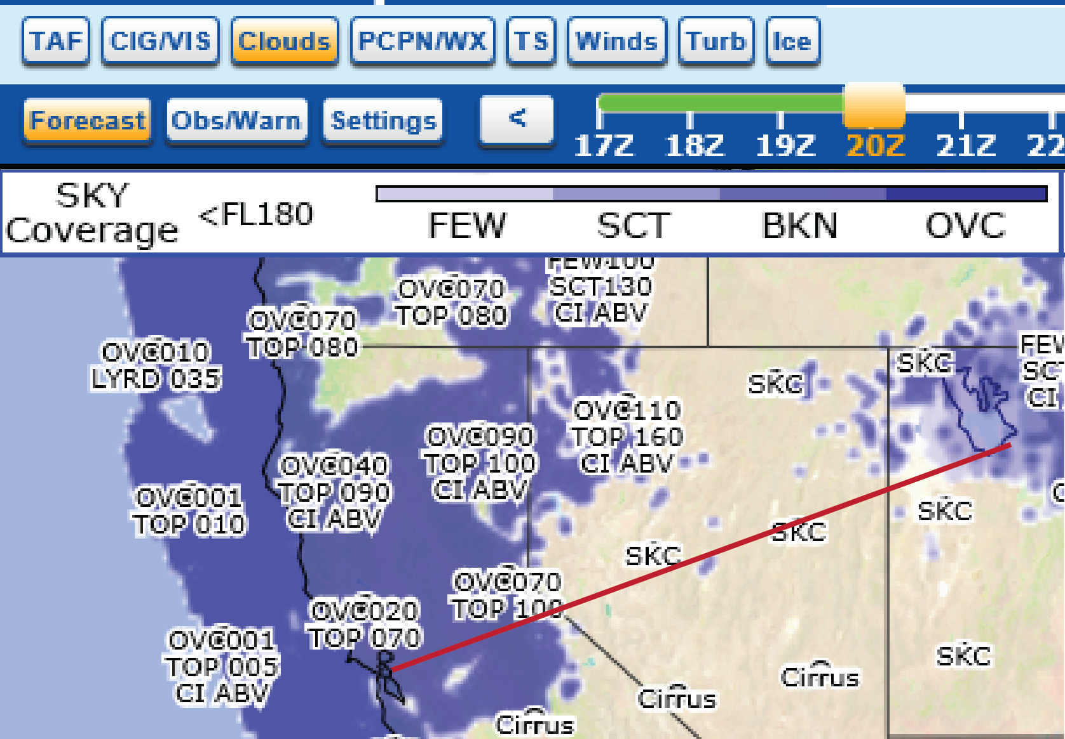
SKY COVER

Slide 19
NOTE
The Rapid Refresh Model (RAP) Low Cloud Tops grid displays clouds below FL180. For convective tops see Convective SIGMETs (WST), convective Center Weather Advisories (CWA), Aviation Watch Notification Messages (AWW), Severe Thunderstorm/Tornado Watch Notification Messages (WW), and the Convective Outlook (AC).

Slide 20
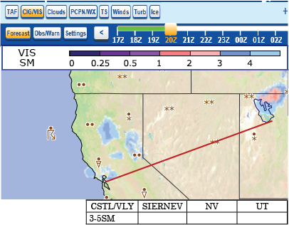
VISIBILITY

Slide 21
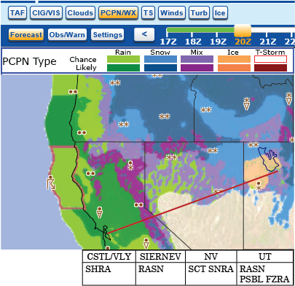
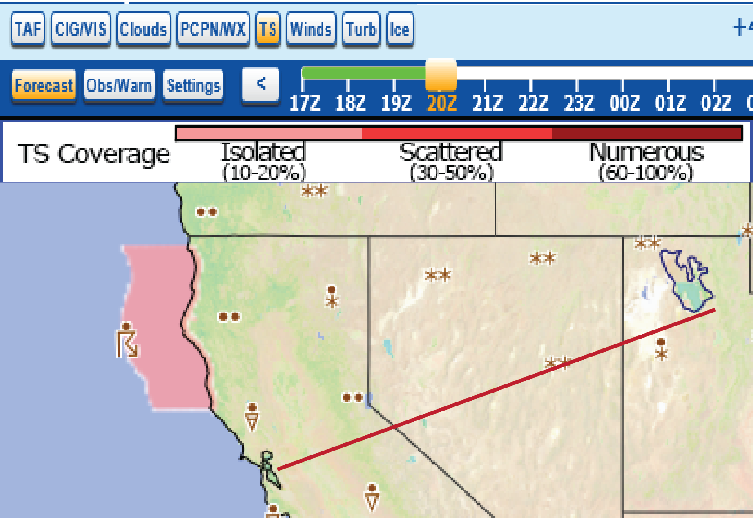
PCPN/WX (Precipitation-Weather; TS (Thunderstorms

Slide 22
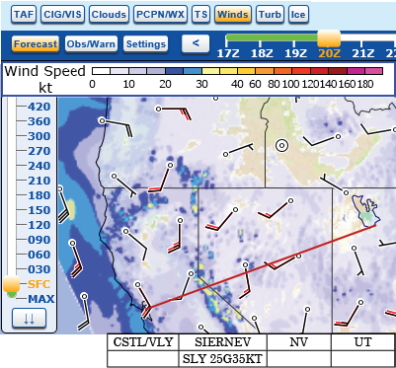
WINDS

Slide 23
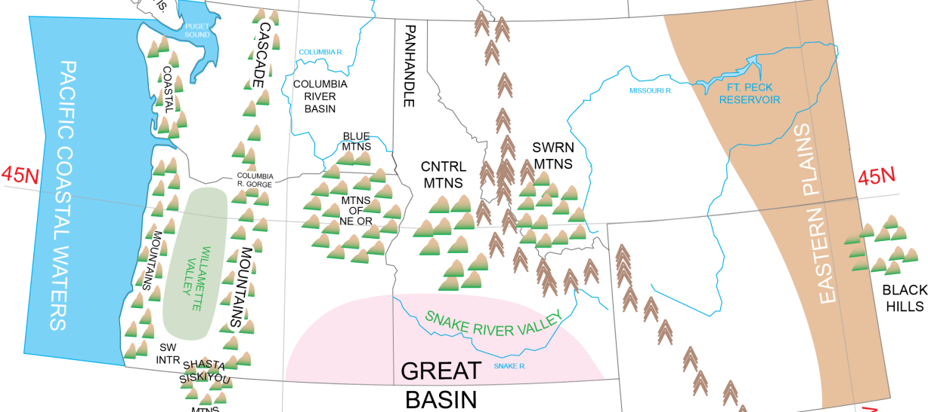
Aviation Surface Forecast and Clouds Forecast Graphics (Portland, OR to Boise, ID)

Slide 24
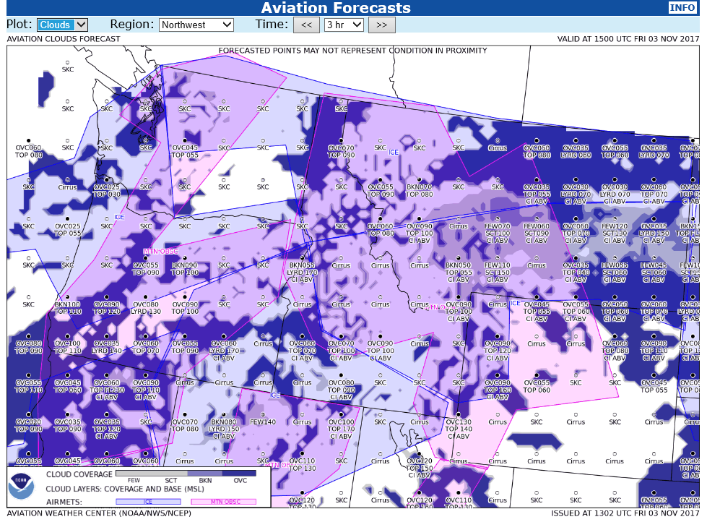
AVIATION CLOUDS FORECAST
Operationally, expect AIRMET phenomena to affect over 50% of the area at any time. Therefore, a pilot might encounter areas within the delineated portion that are NOT affected by the hazard. This is not inconsistent, but reflects the dynamic and transitory nature of weather. From a forecast perspective phenomena usually lies well within the delineated area.
Mountain obscuration typically means VFR flight is possible in the valleys, but may not be possible through mountain passes and particularly across mountain ridges.

Slide 25
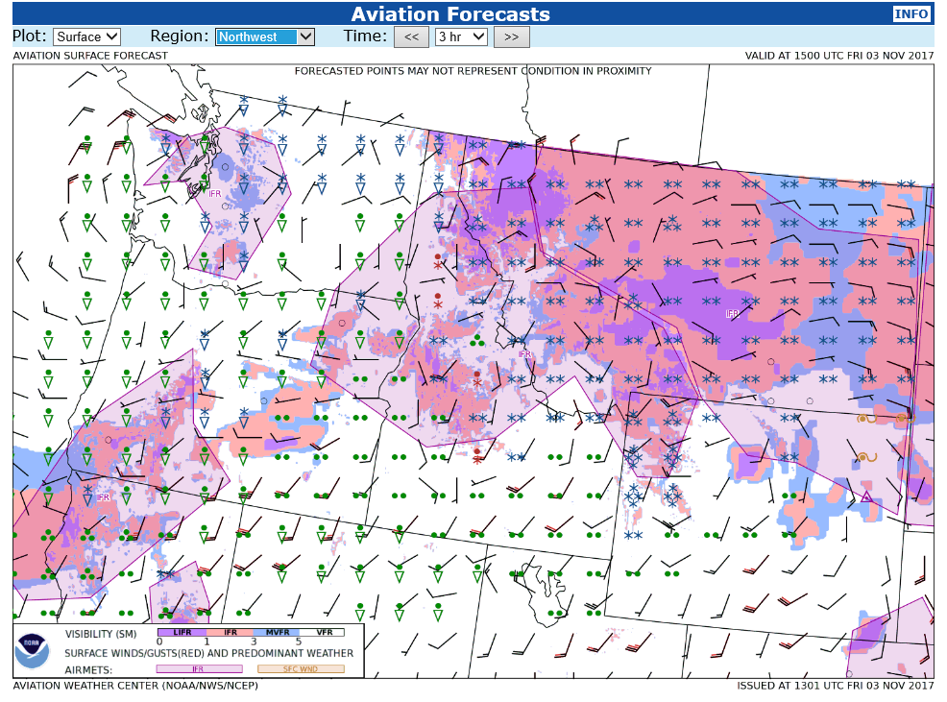
AVIATION SURFACE FORECAST

Slide 26
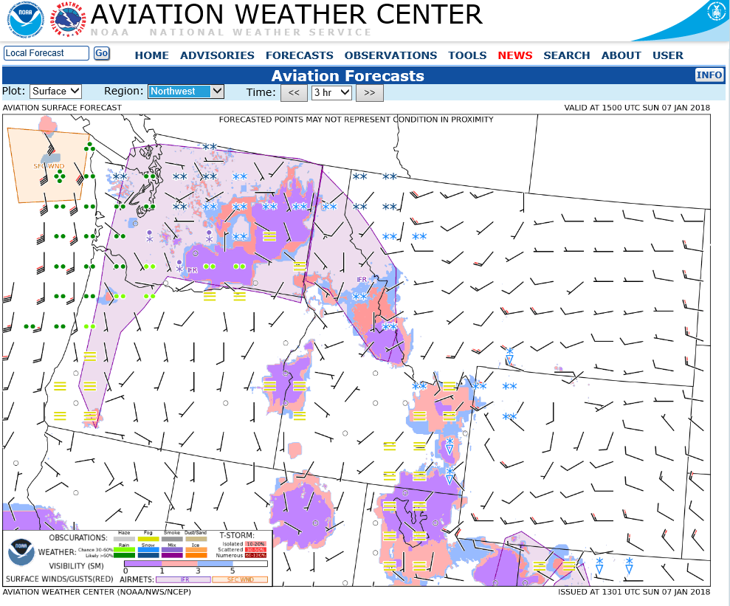
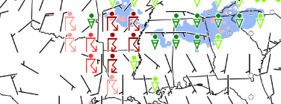

Slide 27
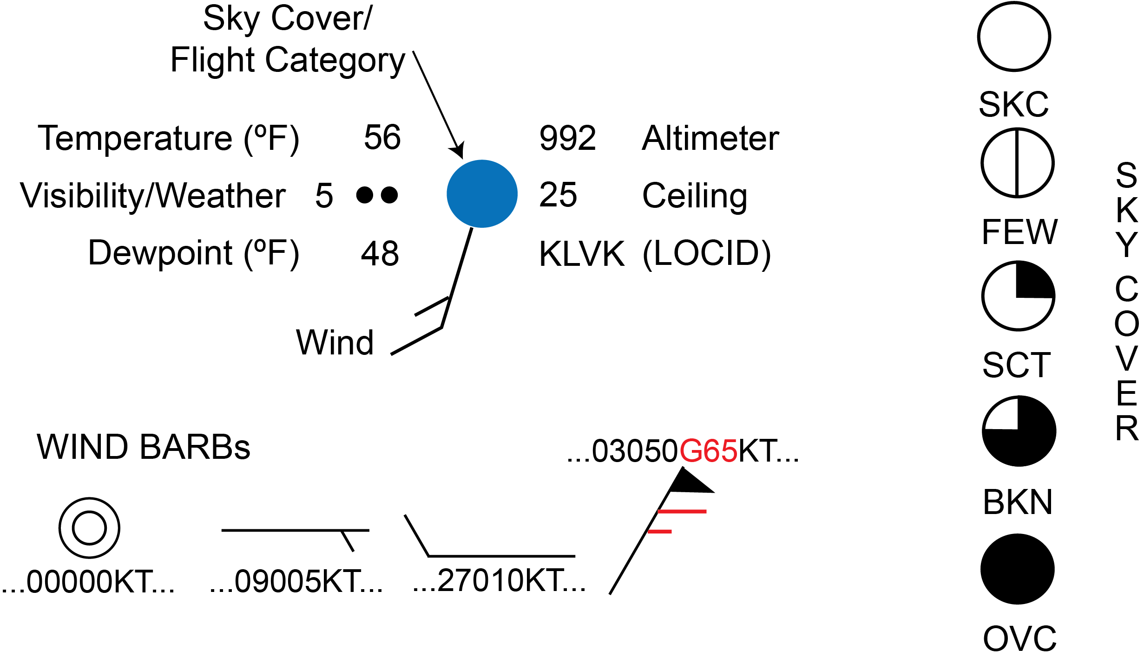

Slide 28
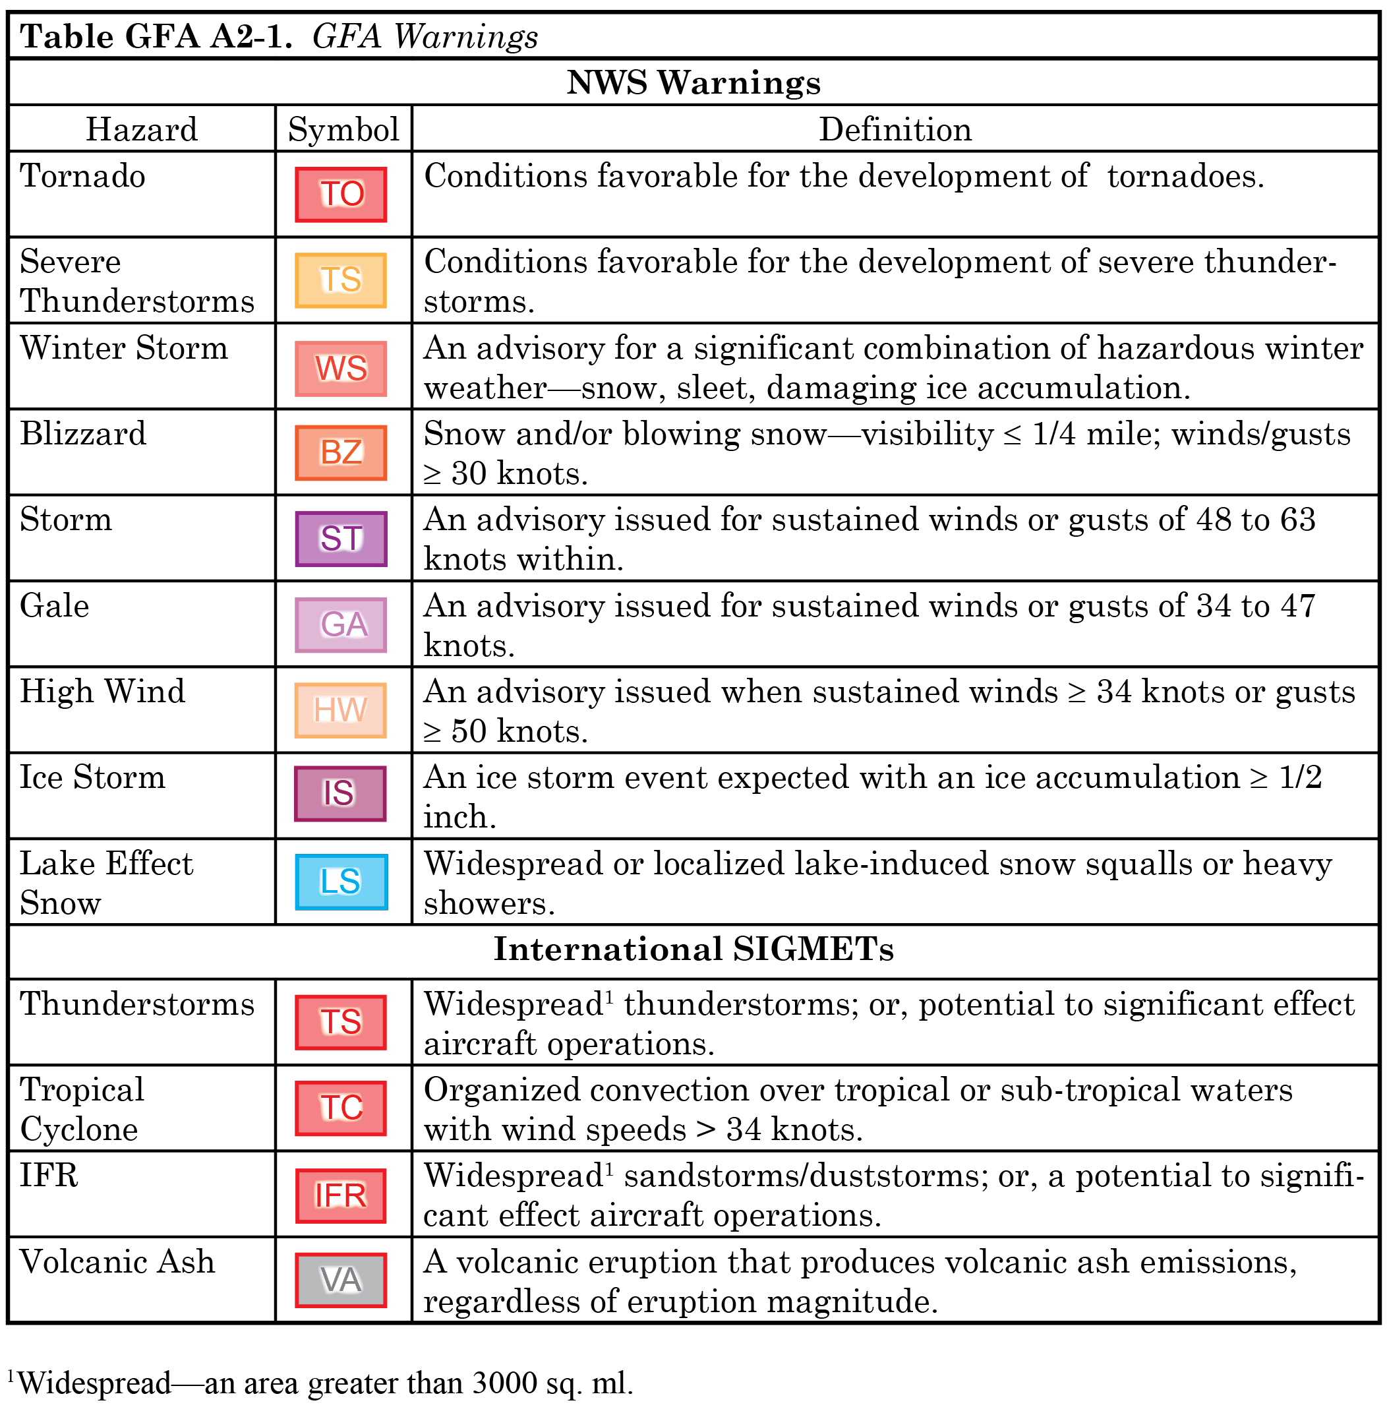

Slide 32
Advantages
Displays for non-meteorologist users.
A single source for multiple products.
Temporal resolution 1 hour.
Arial resolution (overlay) 1.2 nm (2.2 km).
Forecasts to 15 hours.
Available continuously.
Updated continuously.
Display scalable and customizable.

Slide 33
Limitations
Surface/Clouds forecasts temporal resolution 3 hours.
Weather Grids are point forecasts.
No amendments. (Weather Advisories automatically amend the forecast.) WS only displayed during valid period; no CWAs.
Primarily low altitude products—below FL180 (e.g. cloud tops).
Automated; may not be as accurate as forecast with human involvement.
Displays may suffer from clutter.
Users may disable certain overlays, eliminating areas of hazardous weather.

